Slide 1
Introducing barrier filling factor to translate Br into a commercial PM
Dec 30 2015
Mohammad.abshari@polito.it

Slide 2
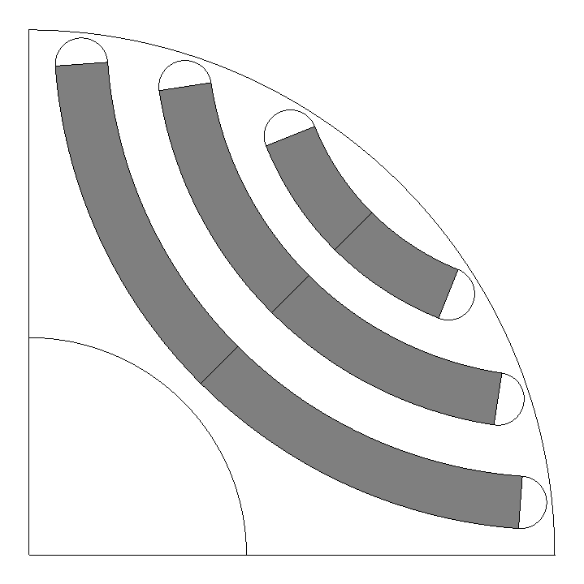
Introduction
For automatic design of PM- assisted motor a new parameter(BarrFillFac) is defined in Syre .
The magnet volume in the barrieres define as barrier filling Factor.
Now just accessible for circular model.
Default value for this parameter is 1.
Magnet area is shown gray color in the Fig.
Magnet area for BarrFillFac=1

Slide 3
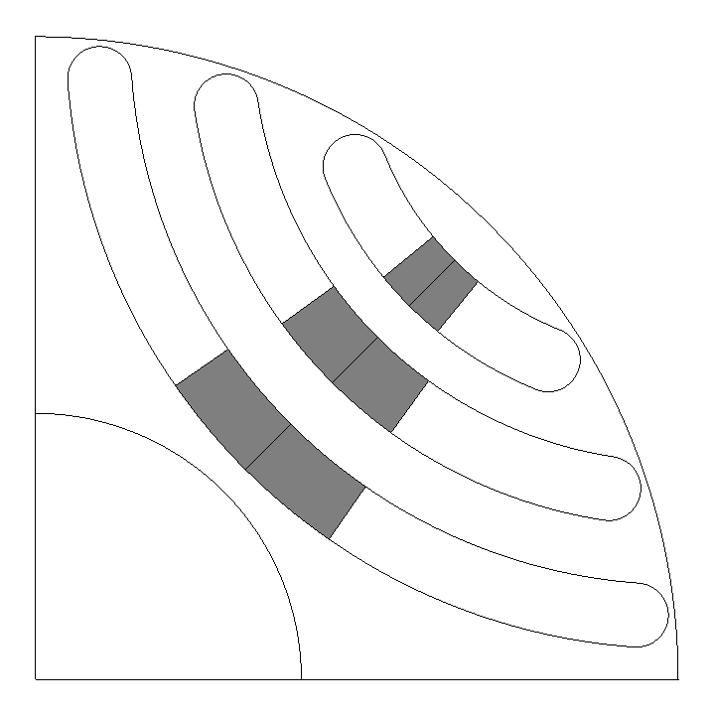
For translating Virtual PMs to commercial magnet in SyR-E, barrier filling factor change with ratio of Br in virtual magnet and real magnet. Ex. To replace commercial magnet with Br=1.2 T instead of virtual magnet with Br=0.3 T , the BarFillFac must be set 0.25 BarFillFac_{(commercial magnet)=}0.3/1.2
Translate to commercial magnet
BarrFillFac=1
Br=0.3
BarrFillFac=0.25
Br=1.2

Slide 4
Based on BarrFillFac magnetization direction is determined

Slide 5
Flux maps
BarrFillFac=1
Br=0.3 T
λ_{m}= 0.141 V.s
BarrFillFac=0.25
Br=1.2 T
λ_{m}= 0.144 V.s

